Slide 1
Digital Portfolios
Shanna Morgan
Haley Melville
Follow us
@TheMsMorgan
@Haley_Melville
Notes:
I

Slide 2
Drag your dot to show you’re ready to move on:
Notes:
🍐 This is a Pear Deck Draggable™ Slide.

Slide 3
Turn and Talk
What questions do you hope to find answers to today?
Have these questions handwritten somewhere.
We will use them later!
Notes:
Shanna

Slide 4
Turn, Talk, and Jot Before we dive in, what are your initial thoughts on the purpose of a portfolio?
Notes:
🍐 This is a Pear Deck Text Slide.

Slide 5
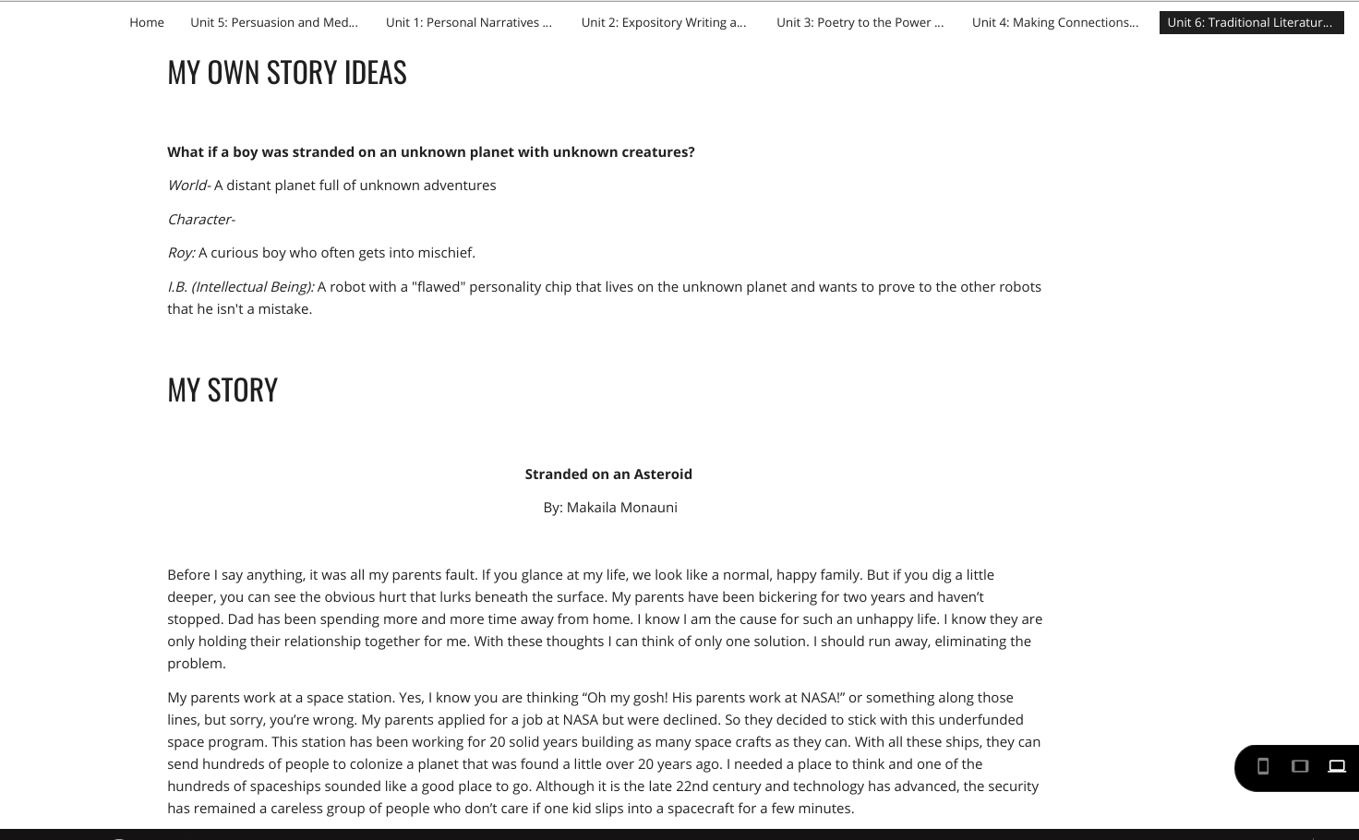
“To allow us to see how we have grown throughout the year”
-7th grade student
Student Feedback - What is the purpose of a portfolio?
Notes:
Haley

Slide 6
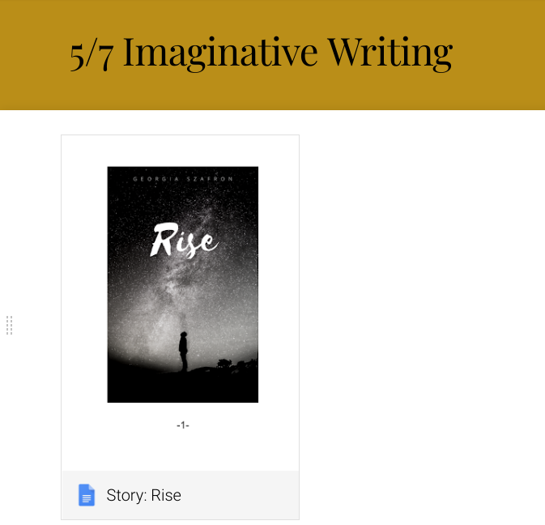
“To allow us to see how we have grown throughout the year”
-7th grade student
“To show all that we have learned through the year and to look back and remind ourselves of what we accomplished.”
-7th grade student
Student Feedback - What is the purpose of a digital portfolio?
Notes:
Haley

Slide 7
Turn, Talk, and Jot What artifacts could you encourage students to put in their portfolio?
Notes:
🍐 This is a Pear Deck Text Slide.
Define artifact for learners

Slide 8
Examples of artifacts I could include
Work from other contents along with a reflection piece showing connections made to ELA skills.
Photographs of quick writes
Photographs of journal entries
Photographs, videos, etc connected to ELA skills.
Independent inquiries
Projects - slideshows, YouTube videos, etc.
Booksnaps
FlipGrid responses

Slide 9
Examples of artifacts I could include
Work from other contents along with a reflection piece showing connections made to ELA skills.
Photographs of quick writes
Photographs of journal entries
Photographs, videos, etc connected to ELA skills.
Independent inquiries
Projects - slideshows, YouTube videos, etc.
Booksnaps
FlipGrid responses
Not everything has to be created digitally! We will look at ways to insert photographs of work later!

Slide 10
Turn, Talk, and Jot
What are some ways you could organize a portfolio?
Notes:
🍐 This is a Pear Deck Text Slide.

Slide 11
Organizing Portfolios
There is no ONE RIGHT way!
By Unit
By Genre
By Reading/Writing Goals
Essential Questions
???
Notes:
Before moving on, make mention of growth

Slide 12
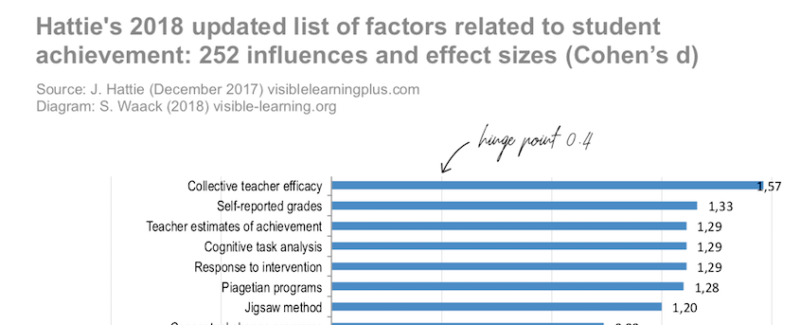
We know looking at growth is important.
Notes:
🍐 This is a Pear Deck Web Slide.
🍐 To edit the type of question, go back to the "Ask Students a Question" in the Pear Deck sidebar.
Allow time for whole group discussion

Slide 13
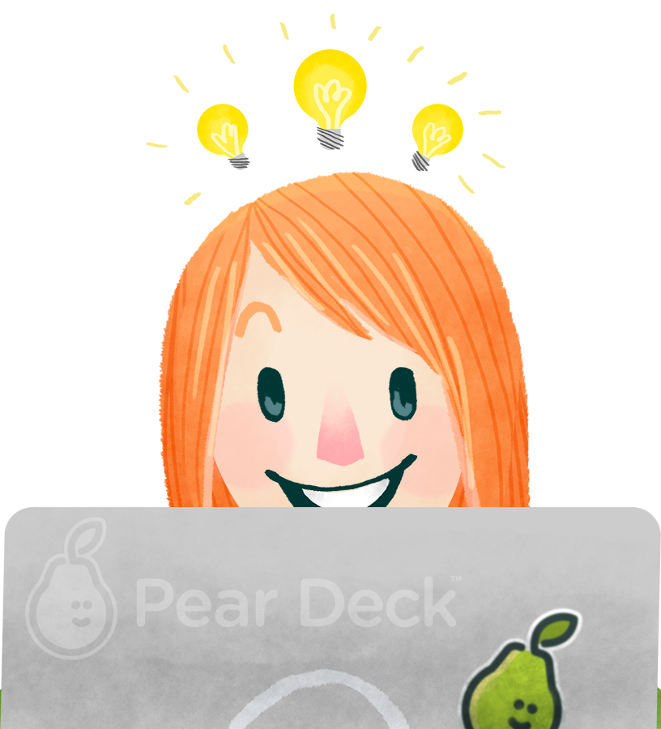
Turn, Talk, and Jot
How do you currently foster a growth mindset in your classroom?
How do you see digital portfolios facilitating this?
Notes:
🍐 This is a Pear Deck Text Slide.

Slide 14
How did I help my students track their growth?
Providing time for reflection!
Notes:
🍐 This is a Pear Deck Web Slide.
🍐 To edit the type of question, go back to the "Ask Students a Question" in the Pear Deck sidebar.
Allow time for whole group discussion

Slide 15
Nuts and Bolts

Slide 16
What platform will I use?
We will be working with Google Sites today.
Each student already has access to this
Safe for students to use
User friendly
Please be sure to check with your campus administration/CTD if you have another resource you’d prefer to use!
Blogger
Canvas E-Portfolio
Bulb
Notes:
Allow for whole group discussion.

Slide 17
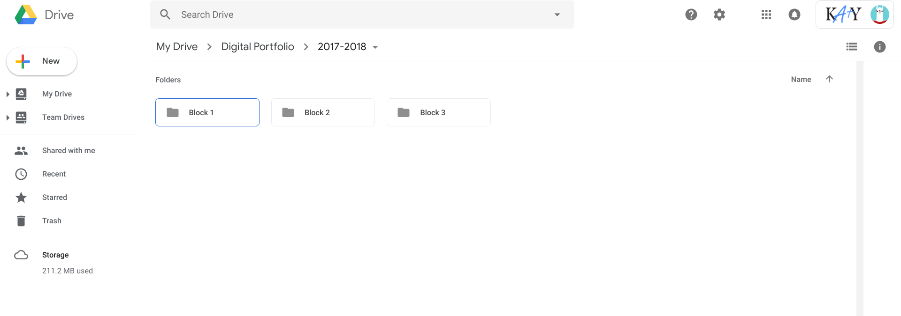
How will I keep track of my students’ digital portfolios?
No right answer here!
With Google Sites, I can use folders in Google Drive!
Step 1: Create folders in your drive that make sense to you. (I organized by class)

Slide 18
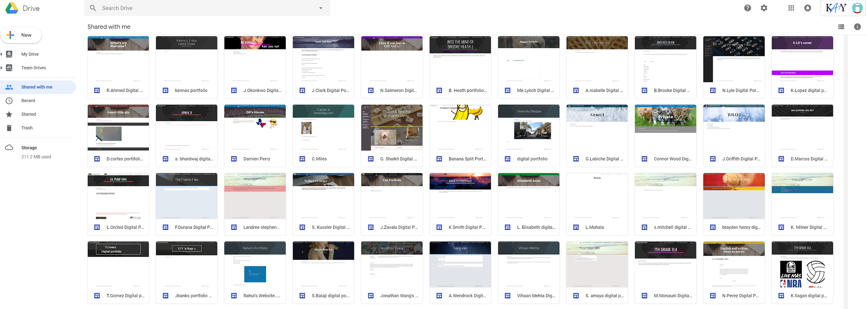
How will I keep track of my students’ digital portfolios?
Step 2: Ask students to share their site with you.
Step 3: Look in the SHARED WITH ME section of your drive.

Slide 19
How will I keep track of my students’ digital portfolios?
Step 4: Drag the sites from your SHARED WITH ME section to MY DRIVE. From there, drag them to the folder of your choice.
***You can also right click the site and use the MOVE TO option.

Slide 20
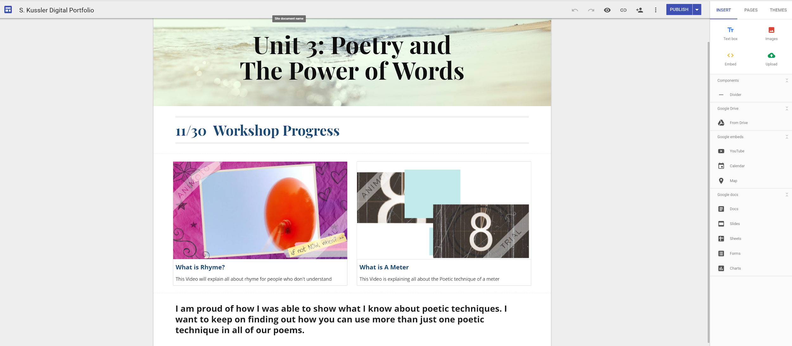
What will it look like for ME?
If they’ve given you editing permission, you will see the same screen they do.

Slide 21
What will it look like for the student?
Let’s try!
You will create a portfolio showcasing your learning during Lit Summit.

Slide 22
Your Lit Summit Portfolio
For the next few steps, you will be switching between tabs!
To open your Google Drive, open a new tab and find your drive.

Slide 23
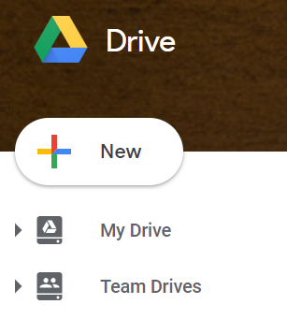
Your Lit Summit Portfolio
1: Sign into your Google Drive
2: Click on the NEW button in the top left corner.
3: Select SITES from the menu.
**You may have to scroll down or hit MORE.
4: Name your site. Last name. First Initial
**EX: Melville.H
5: Give your first page a title. We will call ours LIT SUMMIT 2018.
6: At this time, you would ask your students to share with you. You do this by clicking on the tiny person at the top right. Be sure they give you EDITING permission!
Notes:
🍐 This is a Pear Deck Web Slide.
🍐 To edit the type of question, go back to the "Ask Students a Question" in the Pear Deck sidebar.

Slide 24
How will my students know what to do?
Routine! Consistency! Routine!
Sample schedule - Friday is tech day
Sample schedule - access to tech all week
Monday | Tuesday | Wednesday | Thursday | Friday
Workshop/Conference | Workshop/Conference | Workshop/Conference Selecting pieces to go into portfolio. Write reflections by hand | Workshop/Conference Selecting pieces to go into portfolio. Write reflections by hand | Computer Lab Update portfolios
Monday | Tuesday | Wednesday | Thursday | Friday
Mini lesson / week focus Workshop/Conferences | Tech rotations Workshop/Conferences | Tech rotations Workshop/Conferences | Tech rotations Workshop/Conferences | Tech rotations Workshop/Conferences
Notes:
🍐 This is a Pear Deck Web Slide.
🍐 To edit the type of question, go back to the "Ask Students a Question" in the Pear Deck sidebar.
Allow for whole group discussion.

Slide 25
How do I add something I’ve created in Google Drive?
Let’s try!
Notes:
🍐 This is a Pear Deck Web Slide.
🍐 To edit the type of question, go back to the "Ask Students a Question" in the Pear Deck sidebar.
Allow for whole group discussion.

Slide 26
How do I add a YOUTUBE video?
Let’s try!
Search for WHY DIGITAL PORTFOLIOS
Notes:
🍐 This is a Pear Deck Web Slide.
🍐 To edit the type of question, go back to the "Ask Students a Question" in the Pear Deck sidebar.
Allow for whole group discussion.

Slide 27
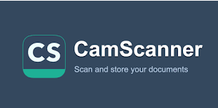
How do I add something I’ve written by hand?
**You have options! What works best for you?
Google Drive App on your phone
Chromebook camera
CamScanner App
Let’s try!
Notes:
Allow for whole group discussion.

Slide 28
What else can I do?
Play!
Take some time now to add new pages.
Name them after the courses you’ve attended today.
Try adding your own photos or notes to these pages.
Notes:
Allow for whole group discussion.

Slide 29
Will my students enjoy using digital portfolios?

Slide 30
Student Feedback - What did you enjoy about using digital portfolios this year?
“I was able to see how I've grow and improved as a writer.”
“I can see what I did this year, because I lost most of my work.”
“I got to personalize the way I liked it, and it made me feel more accomplished looking at all that I have made.”
“I liked how we posted our things and how to do the themes on it and was really cool and creative and I want it for next year as well.”
“Being able to look back at all I have worked on this year and to see what I have improved on.”
“Being able to show my parents everything I’ve been doing in class”
“Nothing really because I thought it was boring”
“I enjoyed seeing my growth.”

Slide 31
Student Feedback - What did you enjoy about using digital portfolios this year?
“Nothing really because I thought it was boring”
Digital Portfolios are a lot of work.
They require commitment from students and teachers.

Slide 32
Turn, Talk, and Jot
If we are spending so much time creating portfolios, how can we use them?
Notes:
🍐 This is a Pear Deck Text Slide.

Slide 33
As you move forward with portfolios, here are a few topics you may wish to discuss with your PLCs.
Time
When do you expect your students to upload work?
How often will you provide feedback on their portfolio?
Choice
Will students be allowed to customize their site?
Will students have choice on what goes into their portfolio?
Audience
Will you provide time for students to share their portfolios with other students?
Other classes?
Other teachers?

Slide 34
Have more questions?
Talk to us!
Shanna Morgan - shannaamorgan@katyisd.org
Or @TheMsMorgan
Haley Melville - haleyrmelville@katyisd.org

