Slide 1
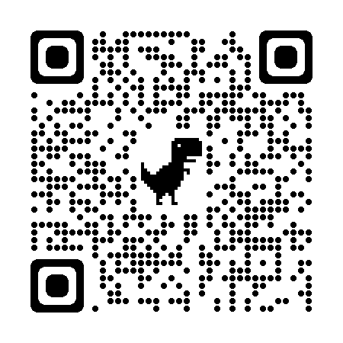
Conducting Challenging Conversations in the Classroom
https://bit.ly/3H2VEBz
Shanna Morgan and Patty Wangler

Slide 2
Rule of Two Feet
Do what is best for your learning today.
Notes:
SM

Slide 3
Every Behavior is a Learned Behavior...
Notes:
SM hatred of cats; love of dogs

Slide 4
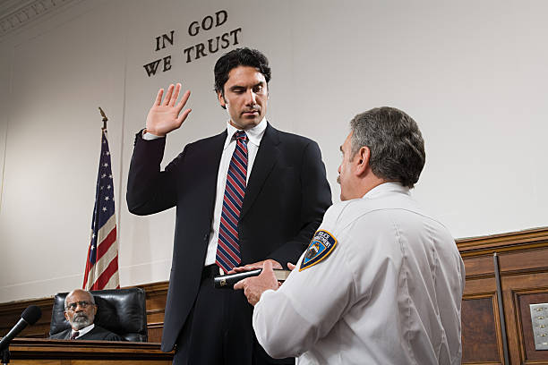
A History of the United States
Notes:
A nation of disgruntled immigrants (Founding Fathers) who settled on stolen land (owned by the Native Americans). That land flourished and grew through hard work and skilled laborers who were underpaid (Slavery). It had moments where we didn’t get along (Civil War). We stand united following tragedies (Columbine, 9/11, Sandy Hook) but sadly...we find a way to revert back to our respective corners and continue our methods of divisiveness.

Slide 5
A History of the United States
A nation of disgruntled immigrants (Founding Fathers) who settled on stolen land (owned by the Native Americans). That land flourished and grew through hard work and skilled laborers who were underpaid (Slavery). It had moments where we didn’t get along (Civil War). We stand united following tragedies (Columbine, 9/11, Sandy Hook) but sadly...we find a way to revert back to our respective corners and continue our methods of divisiveness.
Notes:
A nation of disgruntled immigrants (Founding Fathers) who settled on stolen land (owned by the Native Americans). That land flourished and grew through hard work and skilled laborers who were underpaid (Slavery). It had moments where we didn’t get along (Civil War). We stand united following tragedies (Columbine, 9/11, Sandy Hook) but sadly...we find a way to revert back to our respective corners and continue our methods of divisiveness.

Slide 6
HOW DO WE BOUNCE BACK?
Allow people to tell their story without fear of judgement or contradiction
Learn how to just listen
Speak up for those whose voices have been silenced by tradition or tragedy
NEVER plant your feet!
Evolve from emotions and respond with reality/research
Notes:
SM

Slide 7
Abstract
Texas TEKS now require students to listen, speak, and discuss metacognitively--but how? In these times of change, we must create spaces for students to grow in their ability to have conversations with each other, even the challenging ones. Join us in practicing discussions and walk away with strategies and protocols you can immediately implement in your classroom.
Notes:
PW

Slide 8
Steps for successful integration of crucial conversations -
Create Relationships and Norms
Let them create their own norms (guided)
Address the Awkward
Be okay with some silence (they hate it just as much as we do!)
Give them Structure
Opportunities for Guided Conversation
Fluid Conversation (GOAL!)
Notes:
SM

Slide 9
Discussion Method 1

Slide 10
Time to Think …. Readings as Provocations
Purpose: To share learning, synthesize ideas, become an informed “expert” around a specific topic/concept/issue, and practice listening to learn and understand. This protocol invites you to use multiple literacies to make meaning.
Preview the readings
Choose 1 text to read
Use the Reading Response Think Sheet to hold your thinking so you can engage in conversation
Independent Practice
Notes:
SM- Structure- Give them something to talk about.

Slide 11
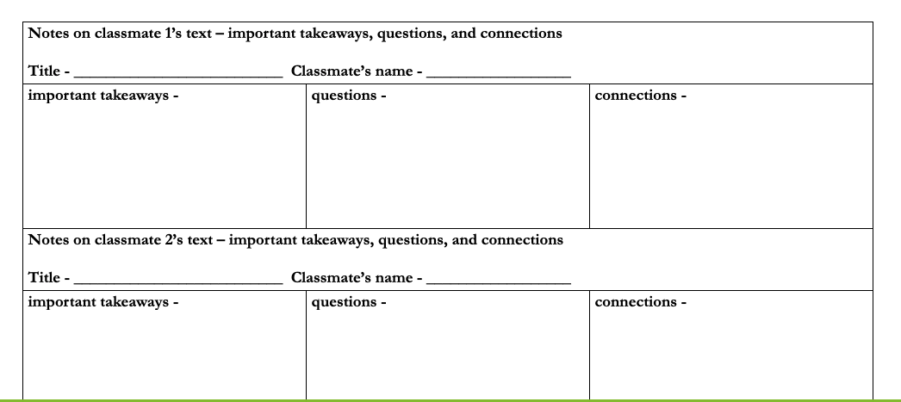
Time to Think …. Readings as Provocations
Small Group:
Round 1: group members with the same reading
Discuss big ideas, pose questions, and share connections
Synthesize and record the most important takeaways to inform others
Collaborative Practice
Notes:
SM- Structure- Give them something to talk about.

Slide 12
Time to Think …. Readings as Provocations
Round 2: group members with different readings
Jigsaw: Each person gets a chance to share the big ideas/thinking/takeaways as listeners jot down ideas on their own “note-catcher.” Listeners can ask questions (ex. to clarify, extend thinking, etc.)
Whole Group: Debrief Process & New Learning
Collaborative Practice
Notes:
SM- Structure- Give them something to talk about.

Slide 13
Discussion Method 2

Slide 14
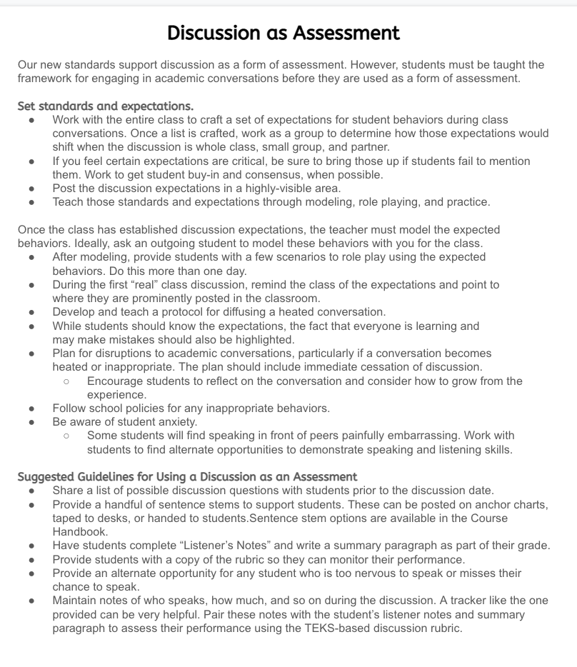
Discussion as Assessment
Suggested Guidelines -

Slide 15
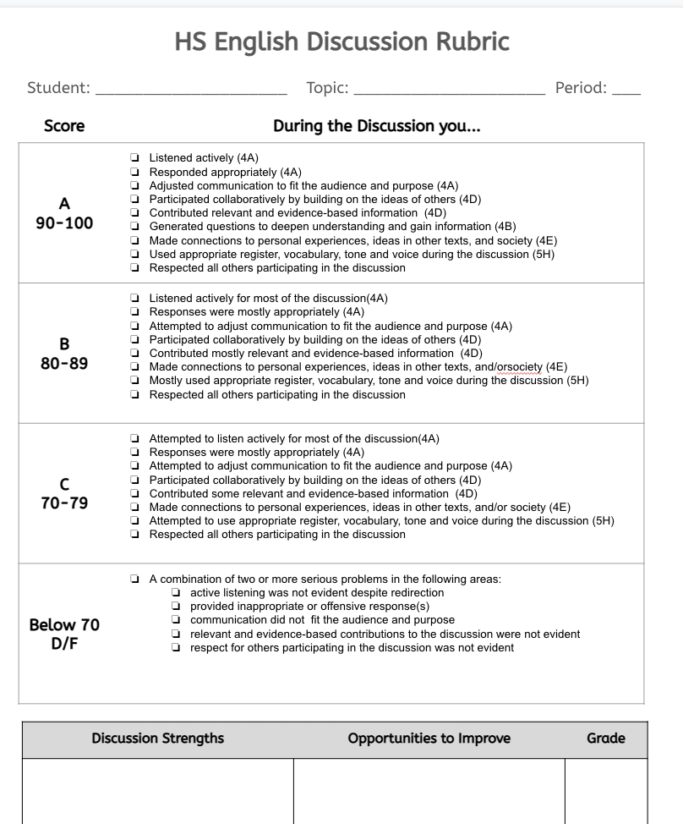

Slide 16
What I use…or a sheet of paper that I just list out each kiddo’s name and my notes based on the key.

Slide 17
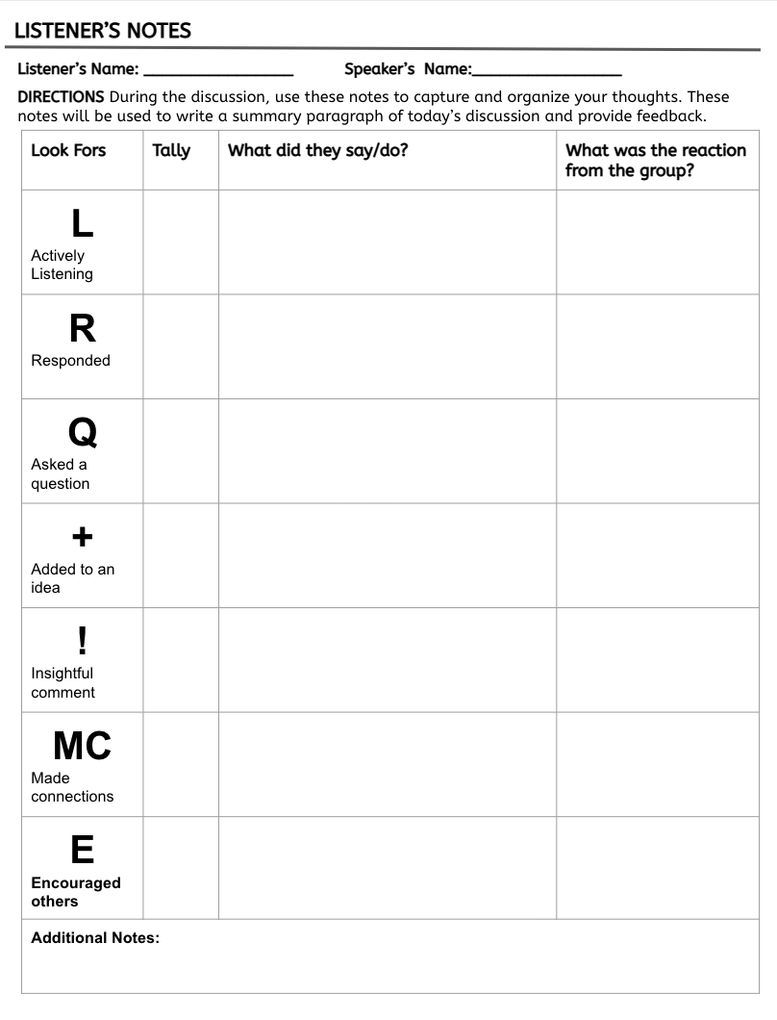

Slide 18
This is my own combination of different styles of discussion, but it works best for me and my kiddos.
Half the class is in the aqua seats of the “circle” and their partner sits directly behind them in the outer gray seats. They are now partners to help each other.
The only people allowed to talk are those in the middle circle. Others who want to speak go to the hot seat (maroon) or simply stand up if there isn’t much room to move. They have the floor immediately.
The outer circle is taking notes on the inner conversation, specifically on the listener’s notes sheet. They are there to take notes and be their partner’s cheerleader.
When they switch, they do the opposite, and then they reflect on how each did using the rubric side of the sheet.

Slide 19
Directions:
4. Write the number of the question you are answering.
5. Answer the question in at least two sentences. Be thoughtful.
6. Students will then write 2 original questions using the stems about the excerpt they want to ask!
Place your MLA header in the top left-hand corner.
Title your paper Discussion Prep
Read the questions about the excerpt; highlight 10 questions you want to answer.
Notes:
PW

Slide 21
Points | Contributions | Points Off | Negative Comments
1 | Asking a question | -2 | Not paying attention
2 | Analyzing the piece | -2 | On your cell phone
2 | Reference the piece as supporting evidence to strengthen your argument. | -2 | Distracting others
2 | Asking a clarifying question or moving the discussion forward. | -2 | Interrupting without cause
2 | Pointing out the purpose of literary elements. | -2 | Attacking others verbally
3 | Connecting to a universal theme in the novel and applying it to. | -2 | Irrelevant comments
3 | Making connections from the novel or our other readings to our current world.
10 pts = 100
9 pts = 90
8 pts = 80
7 pts = 70
6 pts s = 60
5 pts = 50 etc
Remember your Discussion Prep counts towards your grade too!

Slide 22
Comment Stems
I predict that...
One conclusion I can draw is…
Reading this makes me think that…is about to happen
The … isn’t important because…
This reminds me of…
This…is like…because…
This is similar to…
This is different from…
These ideas make me think…
The important information is…
To answer…we need to…
I noticed…
This is good because…
This is confusing because…
I like the part where…because…
I think that…because…
Based on… I would guess that…
I see how this works now because…
Question Stems
Why did…?
How is …like…?
What would happen if…?
In other words, are you saying…?
Do you think that…?
What evidence is found that supports…?

Slide 23
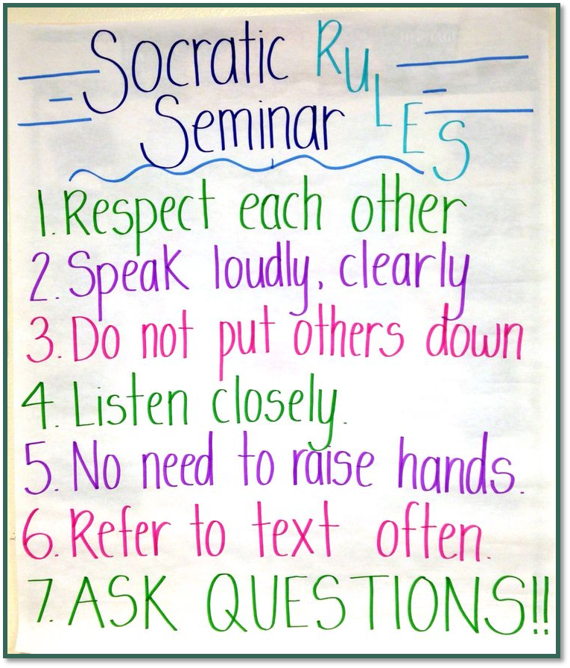
Discussion Time
Today’s Agenda - DO THESE THINGS NOW!! :-)
Take out your (1) Discussion Prep you completed yesterday and your (2) copy of Born a Crime.
You also need a pen or pencil and the notes sheet.
Put your backpack and other materials in the back corner where the stacked desks are located or the front corner under the American Flag. Keep the walkways clear.

Slide 24
Contact
Shanna Morgan:
@TheMsMorgan
shannaamorgan@katyisd.org
Patty Wangler:
@PattyWangler
Patricia.Wangler@gmail.com
Questions/Concerns/Collaborations

Slide 25
Resources
https://bit.ly/3H2VEBz

Slide 26
CEU B780
This is the code you will need when
submitting your professional learning documentation for continuing education units (CEUs).

Slide 27
Works Cited and Resources!
https://doi.org/10.1080/00098655.2020.1762063 Teaching in an Era of Political Divisiveness: An Exploration of Strategies for Discussing Controversial Issues
Heather M. Reynolds, Douglas Silvernell & Freya Mercer (2020) Teaching in an Era of Political Divisiveness: An Exploration of Strategies for Discussing Controversial Issues, The Clearing House: A Journal of Educational Strategies, Issues and Ideas, 93:4, 205-212, DOI: 10.1080/00098655.2020.1762063
https://wac.colostate.edu/resources/teaching/guides/discussions/ - Facilitating Classroom discussions
Kerri Eglin. (2018). Leading Class Discussions. The WAC Clearinghouse. Retrieved from https://wac.colostate.edu/resources/teaching/guides/discussions/. Originally developed for Writing@CSU (https://writing.colostate.edu).
https://www.gse.harvard.edu/news/uk/17/02/talking-race-controversy-and-trauma
Schafer, Leah. "Talking Race, Controversy, and Trauma." Harvard Graduate School of Education, 21 Feb. 2017, www.gse.harvard.edu/news/uk/17/02/talking-race-controversy-and-trauma. Accessed 26 Sept. 2021.
Planning ahead to discuss breaking events and potentially traumatic events with students takes know-how and the space to be able to address these things with students instead of just ignoring them.
https://crlt.umich.edu/publinks/generalguidelines
"Guidelines for Discussing Difficult or High-Stakes Topics." CRLT, crlt.umich.edu/publinks/generalguidelines. Accessed 26 Sept. 2021.

